Slide 1
Using the name in the form instead of the ID

Slide 2
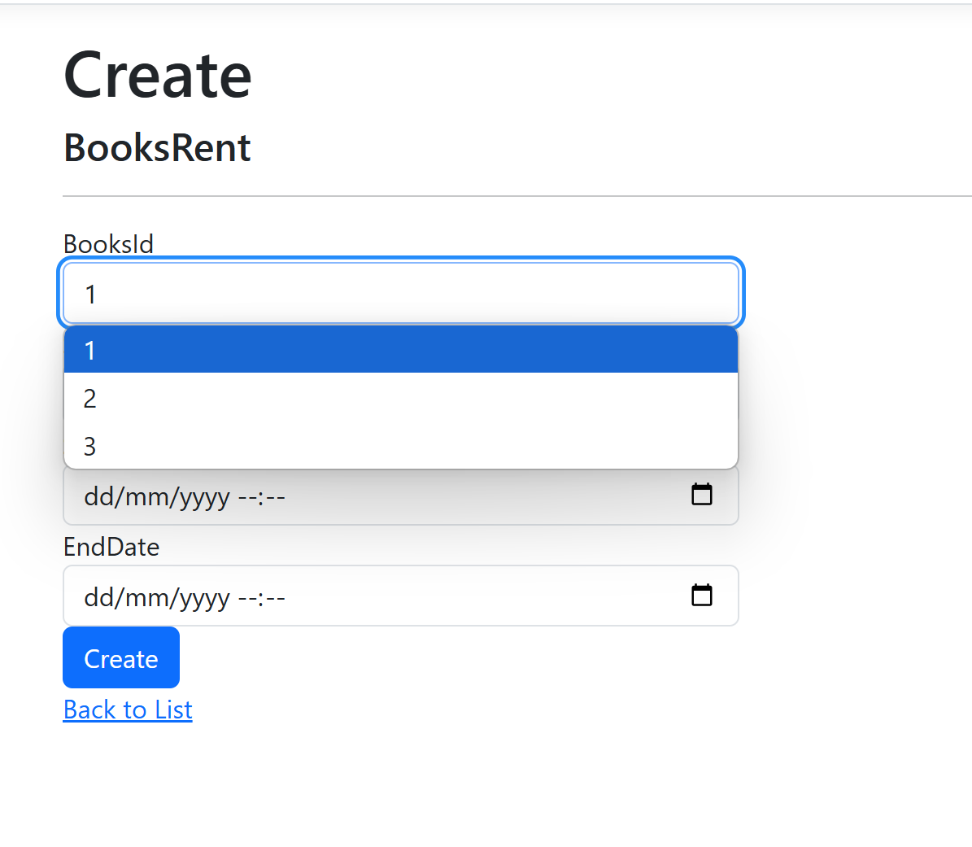
Currently, when you create a new Rental, you must select the Book ID.
We want to change this, so they select the book name.

Slide 3
Don't need to make changes to the model, Just change the dropdown list.

Slide 4
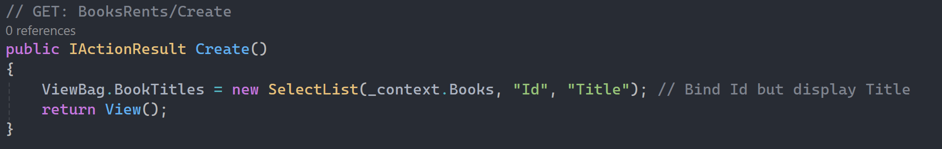
New GET Create
Changed the drop down list ViewBag items so it still links the Id but it displays the title.

Slide 5
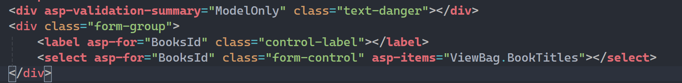
Update the Viewbag in the Create HTML Page
Changed the asp-items in the view to match the new viewBag

Slide 6
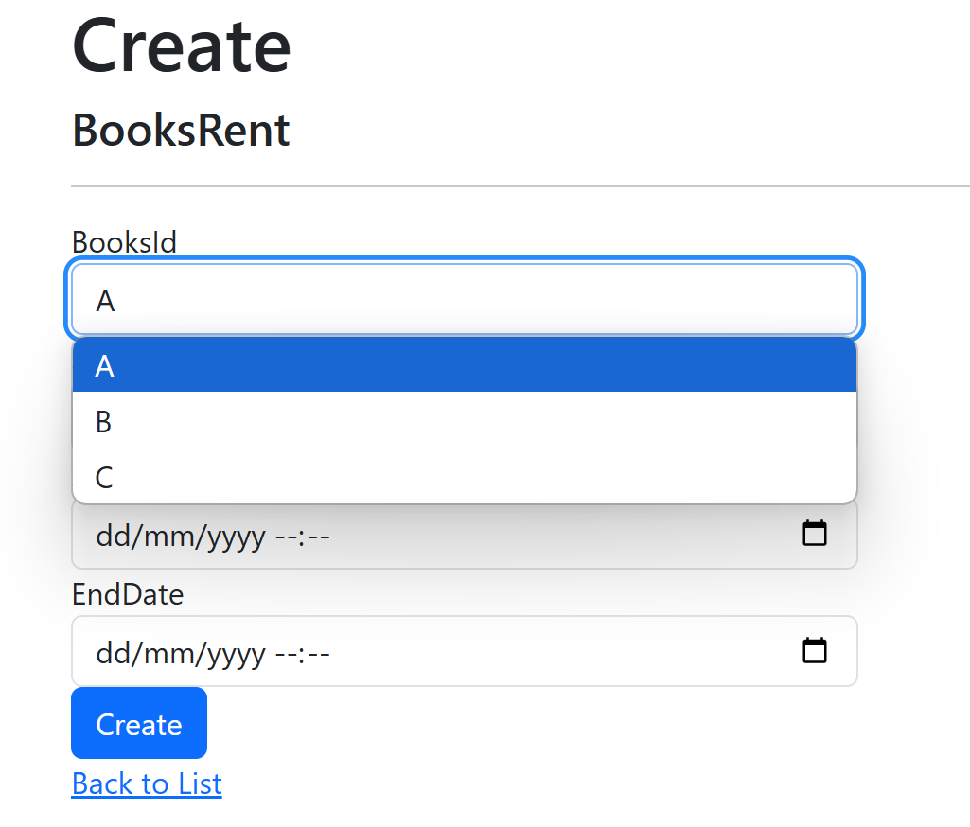
Now we can select the Book Title instead of the Book ID.
Can update the label for the form if you want.

